Slide 1
Instructor: Amit Kumar Das
Lecture 7
Lecturer,
Department of Computer Science & Engineering,
East West University
Dhaka, Bangladesh.

Slide 2
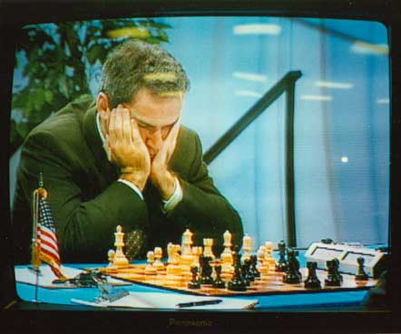
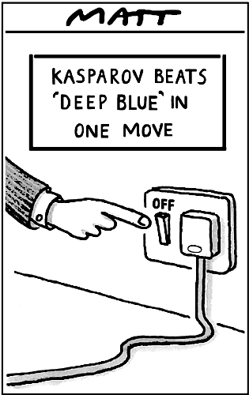
Games and adversarial search (Chapter 5)
World Champion chess player Garry Kasparov is defeated by IBM’s Deep Blue chess-playing computer in a six-game match in May, 1997 (link)
© Telegraph Group Unlimited 1997

Slide 3
Why study games?
Games are a traditional hallmark of intelligence
Games are easy to formalize
Games can be a good model of real-world competitive or cooperative activities
Military confrontations, negotiation, auctions, etc.

Slide 4
Types of game environments
 | Deterministic | Stochastic
Perfect information (fully observable)
Imperfect information (partially observable)
Chess, checkers, go
Backgammon, monopoly
Battleships
Scrabble, poker, bridge

Slide 5
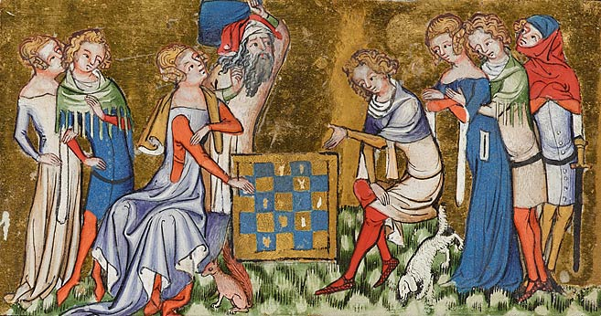
Alternating two-player zero-sum games
Players take turns
Each game outcome or terminal state has a utility for each player (e.g., 1 for win, 0 for loss)
The sum of both players’ utilities is a constant

Slide 6
Games vs. single-agent search
We don’t know how the opponent will act
The solution is not a fixed sequence of actions from start state to goal state, but a strategy or policy (a mapping from state to best move in that state)
Efficiency is critical to playing well
The time to make a move is limited
The branching factor, search depth, and number of terminal configurations are huge
In chess, branching factor ≈ 35 and depth ≈ 100, giving a search tree of 10¹⁵⁴ nodes
Number of atoms in the observable universe ≈ 10⁸⁰
This rules out searching all the way to the end of the game

Slide 7
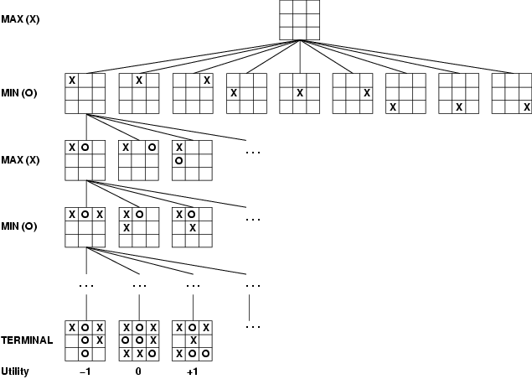
Game tree
A game of tic-tac-toe between two players, “max” and “min”

Slide 8
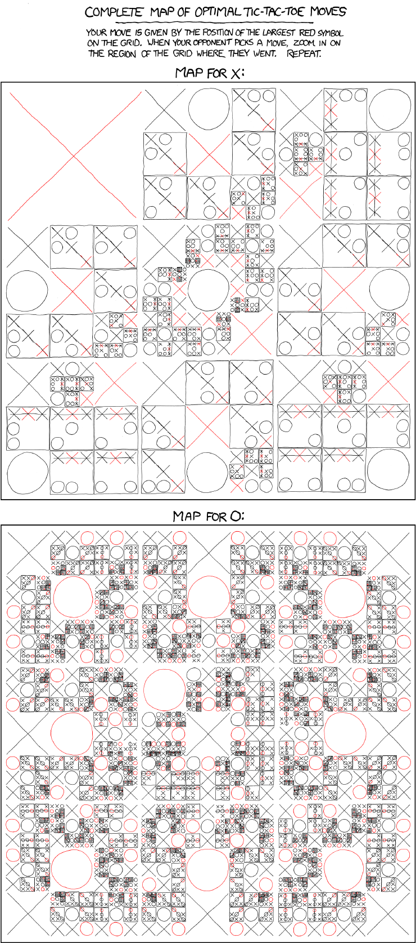
http://xkcd.com/832/

Slide 9
http://xkcd.com/832/

Slide 10
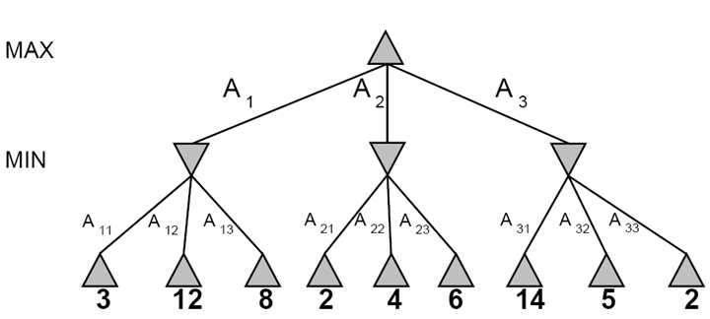
A more abstract game tree
Terminal utilities (for MAX)
A two-ply game

Slide 11
Game tree search
3
3
2
2
Minimax value of a node: the utility (for MAX) of being in the corresponding state, assuming perfect play on both sides
Minimax strategy: Choose the move that gives the best worst-case payoff

Slide 12
Computing the minimax value of a node
3
3
2
2
Minimax(node) =
Utility(node) if node is terminal
max_{action} Minimax(Succ(node, action)) if player = MAX
min_{action} Minimax(Succ(node, action)) if player = MIN

Slide 13
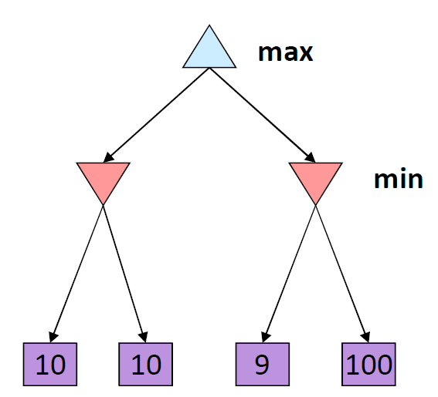
Optimality of minimax
The minimax strategy is optimal against an optimal opponent
What if your opponent is suboptimal?
Your utility can only be higher than if you were playing an optimal opponent!
A different strategy may work better for a sub-optimal opponent, but it will necessarily be worse against an optimal opponent
11
Example from D. Klein and P. Abbeel

Slide 14
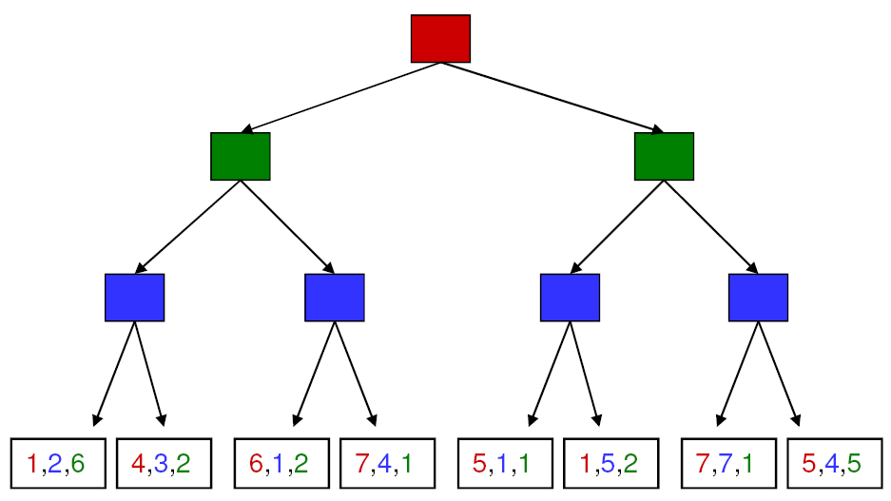
More general games
4,3,2
4,3,2
1,5,2
4,3,2
7,4,1
1,5,2
7,7,1
More than two players, non-zero-sum
Utilities are now tuples
Each player maximizes their own utility at their node
Utilities get propagated (backed up) from children to parents

Slide 15
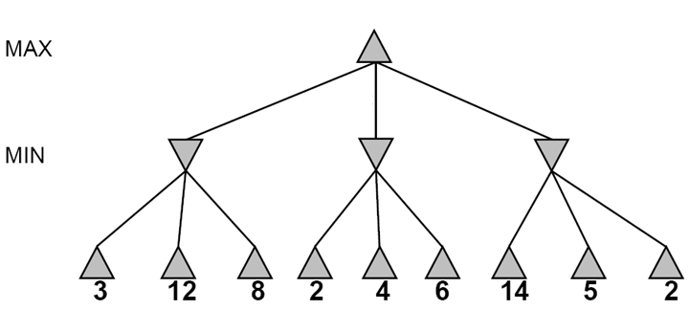
Alpha-beta pruning
It is possible to compute the exact minimax decision without expanding every node in the game tree

Slide 16
Alpha-beta pruning
It is possible to compute the exact minimax decision without expanding every node in the game tree
≥3
3

Slide 17
Alpha-beta pruning
It is possible to compute the exact minimax decision without expanding every node in the game tree
≥3
3
≤2

Slide 18
Alpha-beta pruning
It is possible to compute the exact minimax decision without expanding every node in the game tree
≥3
3
≤2
≤14

Slide 19
Alpha-beta pruning
It is possible to compute the exact minimax decision without expanding every node in the game tree
≥3
3
≤2
≤5

Slide 20
Alpha-beta pruning
It is possible to compute the exact minimax decision without expanding every node in the game tree
3
3
≤2
2
Notes:
Could we have done better with the right branch?

Slide 21
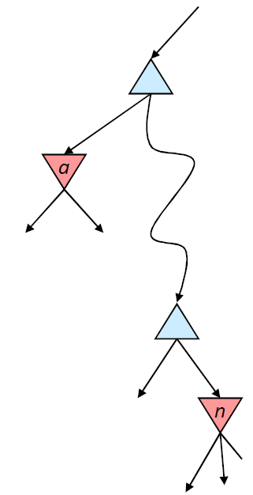

Alpha-beta pruning
α is the value of the best choice for the MAX player found so far at any choice point above node n
We want to compute the MIN-value at n
As we loop over n’s children, the MIN-value decreases
If it drops below α, MAX will never choose n, so we can ignore n’s remaining children
Analogously, β is the value of the lowest-utility choice found so far for the MIN player

Slide 22
Alpha-beta pruning
Function action = Alpha-Beta-Search(node)
v = Min-Value(node, −∞, ∞)
return the action from node with value v
α: best alternative available to the Max player
β: best alternative available to the Min player
Function v = Min-Value(node, α, β)
if Terminal(node) return Utility(node)
v = +∞
for each action from node
v = Min(v, Max-Value(Succ(node, action), α, β))
if v ≤ α return v
β = Min(β, v)
end for
return v
node
action
…
Succ(node, action)

Slide 23
Alpha-beta pruning
Function action = Alpha-Beta-Search(node)
v = Max-Value(node, −∞, ∞)
return the action from node with value v
α: best alternative available to the Max player
β: best alternative available to the Min player
Function v = Max-Value(node, α, β)
if Terminal(node) return Utility(node)
v = −∞
for each action from node
v = Max(v, Min-Value(Succ(node, action), α, β))
if v ≥ β return v
α = Max(α, v)
end for
return v
node
action
…
Succ(node, action)

Slide 24
Alpha-beta pruning
Pruning does not affect final result
Amount of pruning depends on move ordering
Should start with the “best” moves (highest-value for MAX or lowest-value for MIN)
For chess, can try captures first, then threats, then forward moves, then backward moves
Can also try to remember “killer moves” from other branches of the tree
With perfect ordering, the time to find the best move is reduced to O(b^{m/2}) from O(b^{m})
Depth of search is effectively doubled

Slide 25
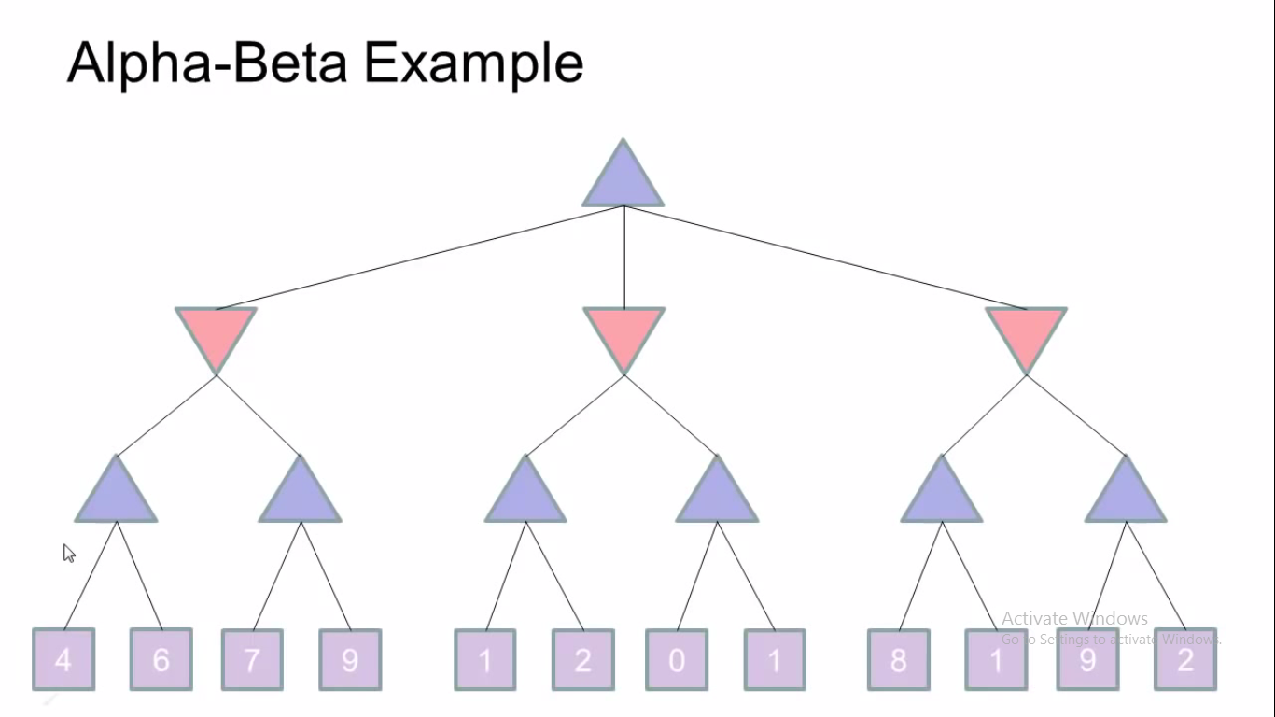

Slide 26
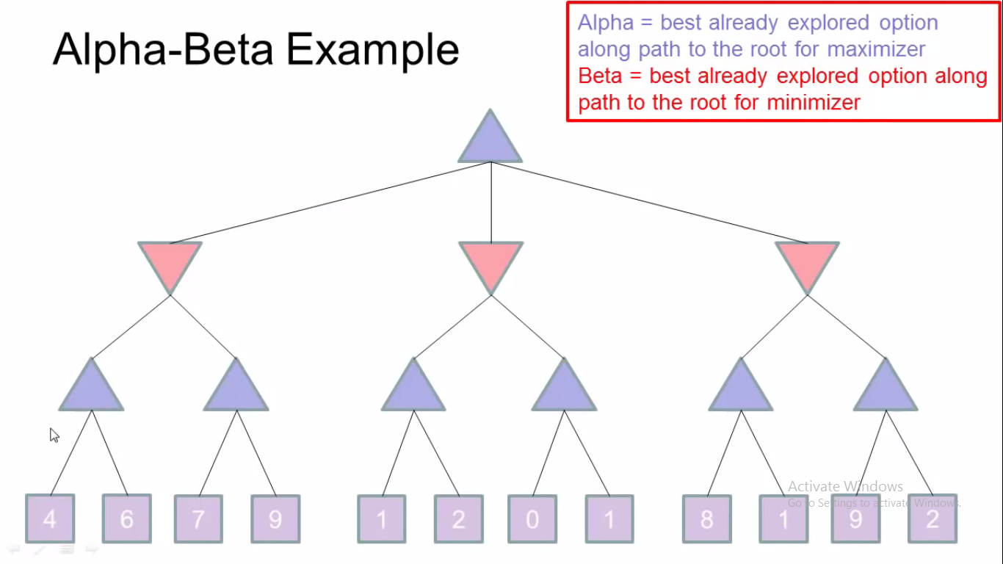

Slide 27
Thank You

